Slide 1

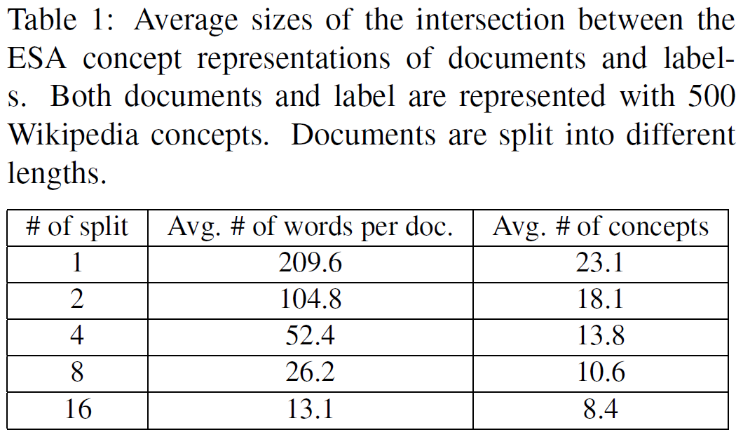
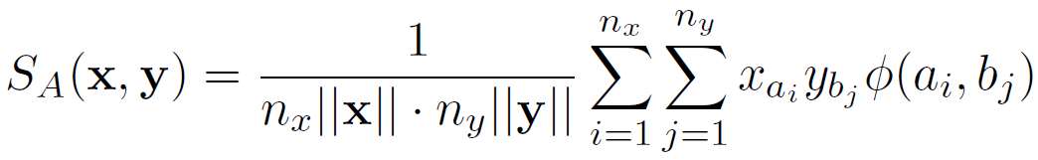
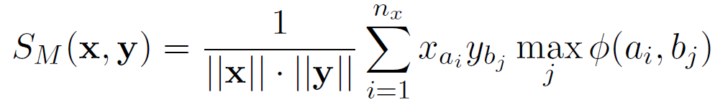
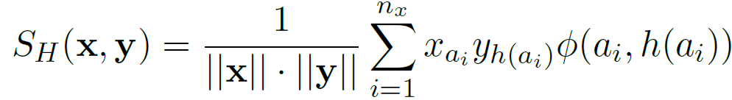
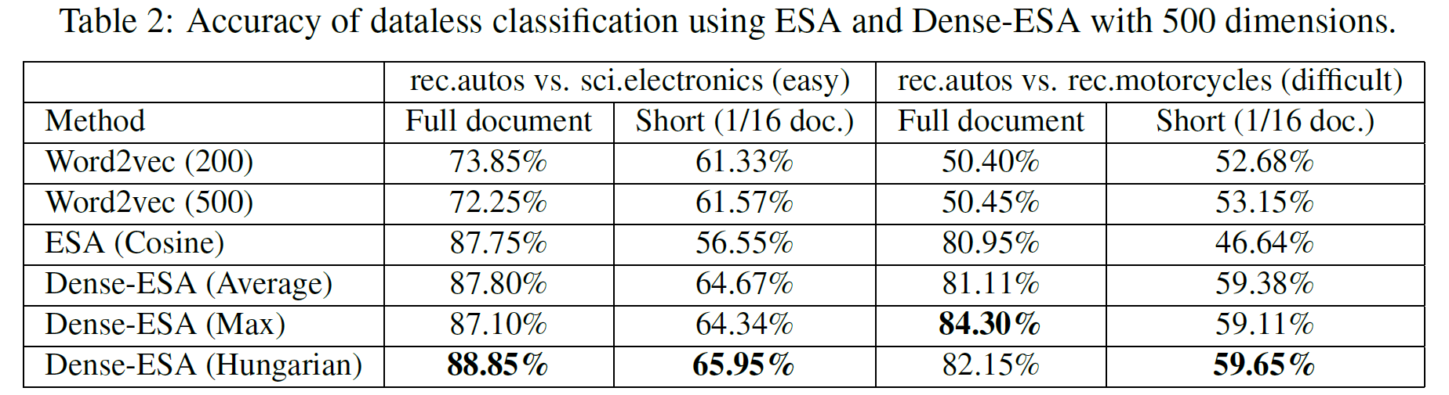
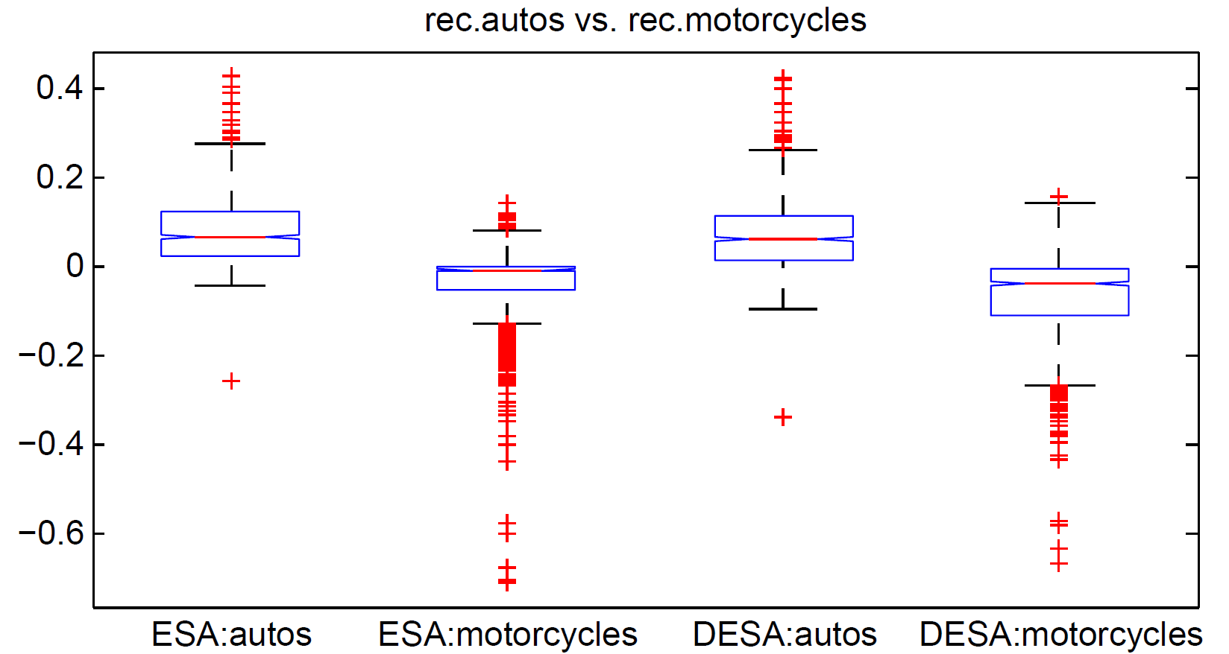
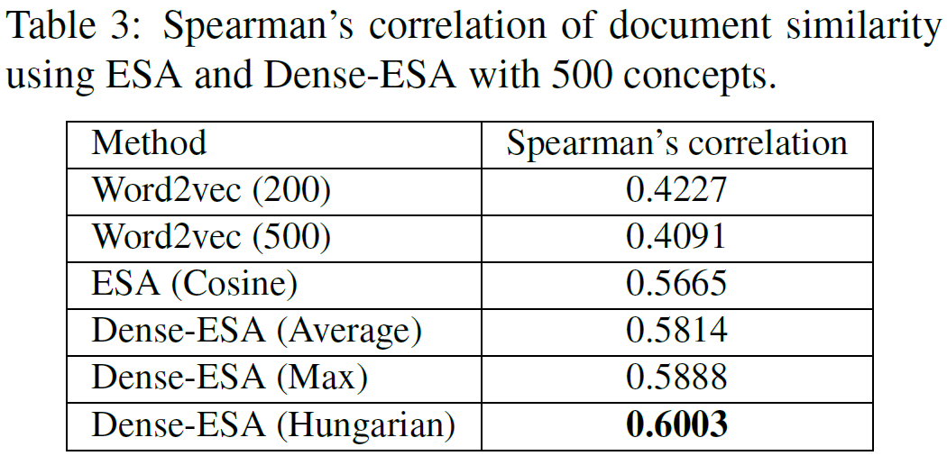
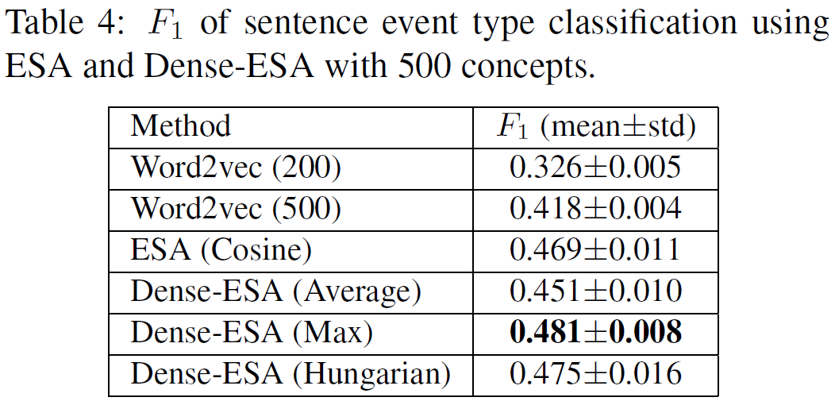
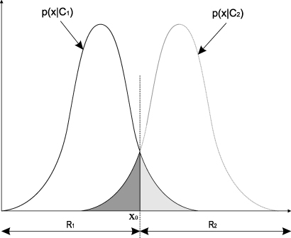



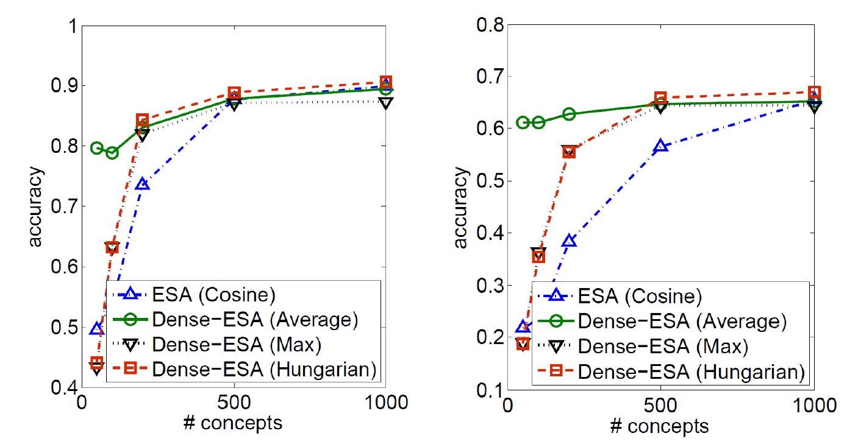
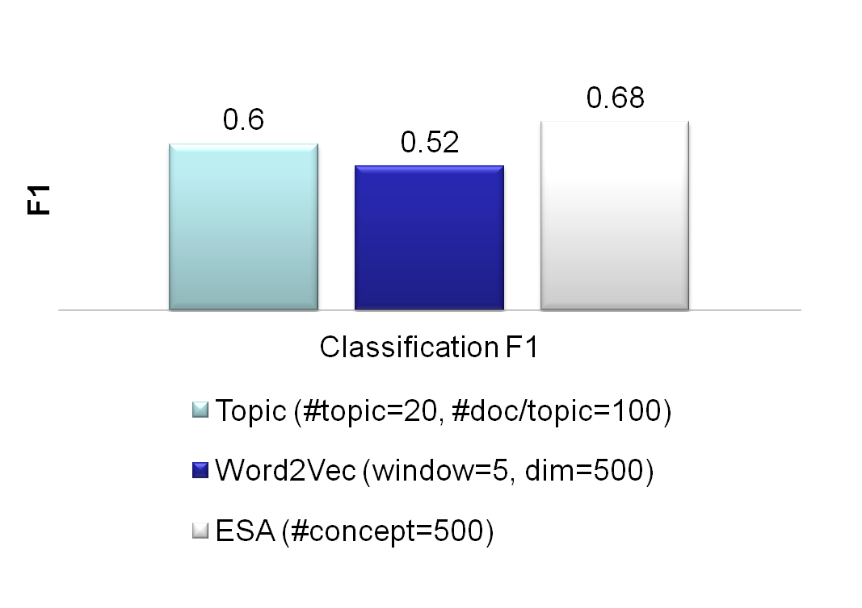
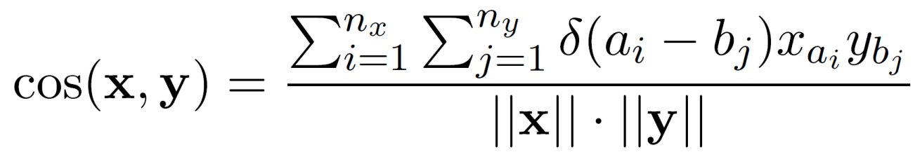
Unsupervised Sparse Vector Densification for Short Text Similarity
Yangqiu Song and Dan Roth
Computer Science Department, University of Illinois at Urbana-Champaign
Abstract
Other Representations
Similarity Densification
Sparse representations of text such as bag-of-words models or explicit semantic analysis (ESA) representations are commonly used in NLP applications. However, for short texts, the similarity between two such sparse vectors is not accurate due to small term overlap. We propose a way to combine ESA representations and word2vec representations as a way to generate denser topical representations and, consequently, a better similarity measure between short texts. We study three densification mechanisms that involve different alignments of the representations and show the effectiveness of these to measuring similarity between short texts. We present a generic, unsupervised method, that is not trained on the target collection.
Explicit Semantic Analysis (ESA)
  ESA:
    Topic related tasks
    Still has sparsity problem
  Word2vec:
    Local context related representation
    Word context similarity
    Our solution: avoid sparsity by replacing each component in ESA representation by its Word2vec representation
Gabrilovich and Markovitch. JAIR. 2009.
  Vector x
  Vector y
Average
  Build inverted index of Wikipedia
  Word is represented as a vector of all Wikipedia titles it appears in
  Text representation is based on average of all words’ representations
  1.0
Barack Obama
Timeline of the presidency of Barack Obama (2009)
Family of Barack Obama
Barack Obama citizenship conspiracy theories
Barack Obama
Barack Obama presidential primary campaign 2008
  0.9
Max
Unsupervised Text Similarity
  0.7
Hungarian
Many applications
Text clustering
Dataless classification
Information extraction
Coreference
Wikification
Paraphrasing
Fully unsupervised similarity measure
Given two pieces of short texts
Generic similarity
Distributed Word Embedding
  Mikolov et. al. NIPS and HLTNAACL. 2013.
  Collobert et. al. JMLR 2011. (Senna)
  Turian et. al, ACL, 2010.
  Many earlier distributed word representation…
Results
Results
  Distributed word embeddings based on local context
  Text representation can be computed based on average of all words’ representations
  20-newsgroups data set
Sparse Vector Representation of Text
Dataless Text Classification
Label
Label Representation
  Document similarity (M. Lee et al., CogSci, 2005)
  Event classification (ACE2005, 8 types)
Text 1: Champaign police make arrest in armed robbery cases
Text 2: Two arrested in UI campus armed robbery
For sparse vectors, most of the elements can be zero. Aligning the indices can result in zero similarity even though the two pieces of texts are related.
Word Representation
Similarity
  Distribution comparison:
  and are similarities between document and two labels
  The boxplot is the distribution of
Champaign
Police
Make
Arrest
Armed
Robbery
Cases
Two
Arrested
UI
Campus
…
1
1
1
1
1
1
1
1
1
1
1
1
1
Document
Document Representation
Method | Representation | Feature
Bag-of-words | Sparse Vector | Words’ TFIDF in non-zero elements
ESA | Sparse Vector | Wikipedia concept weights in non-zero elements
Word Embedding | Dense Vector | Compact real values
Results
Conclusions
  Results on changing the number of concepts used in ESA
A combination of ESA and word2vec
Topic related
Context related
Related work in other communities
Zero shot learning = Dataless Classification
Kernel two-sample test (set kernel/set similarity)
Learning to match
Future work
Bootstrapping (as dataless classification)
Semi-supervised similarity learning
  Data less classification results on 20-newsgroups data set
Text 1
Text 2
This work is supported by the Multimodal Information Access & Synthesis Center at UIUC, part of CCICADA, a DHS Science and Technology Center of Excellence, by the Army Research Laboratory (ARL) under agreement W911NF-09-2-0053, and by DARPA under agreement number FA8750-13-2-0008.

